Slide 1
Capital Budget
October 6th, 2022
Wenchen Wang

Slide 2
Last Week
Cost Definitions
Incremental Cost-Analysis
Break-even Analysis
Cost Allocation
Notes:
Full/Total Cost: Amount paid to obtain resources for the organization’s desired use
Direct & Indirect cost: Cost of resources used directly to provide a good or a service vs. Costs of resources not used directly to provide service (overhead)
Fixed & Variable Cost: costs which remain (relatively) unchanged in total for some time period as the volume of services changes over a relevant range of activity vs. costs that vary directly with changes in the volume of service units over a relevant range of activity (Step Fixed/variable cost)
Average cost: is the total cost of a cost object divided by the number of units of output/volume provided.
Marginal Cost: The additional cost of adding one additional unit of good or service (formula)
Incremental Cost Analysis: MR & MC
Break-even Analysis: BEQ= FC
(P – VC)
Cost Allocation:
Overhead rate = Cost pool/Cost base; Cost allocation = overhead rate * new cost base
Activity Based Costing: $ABC Cost Allocation=\sum{cost base for each acitivities∗unit cost for each acitivities}$

Slide 3
Learning Objectives
Capital Budget Definitions
Depreciation
Time Value of Money (TVM)
Evaluating Capital Investments

Slide 4
Capital Budget
Capital asset – Provide goods/services in more than one fiscal year
Large investments – mistakes can be costly
Long-term investments – Can hamper the organization for many years
Since the cash the organization uses to buy capital assets is not free, managers or policy makers must include the opportunity costs of that money in their analysis.
Notes:
A capital budget is prepared separately from the operating and cash budgets, and it becomes part of the organization’s master budget. A capital acquisition generally requires a large up-front expenditure, followed by some combination of mortgage and interest payments, rent, maintenance, and other ongoing expenses. The process of planning for the purchase of capital assets is capital budgeting.
A capital asset is anything the organization acquires that will help it provide goods or services in more than one fiscal year.
Why separate: the upfront payment for the capital assets so large that the project might be rejected as being totally unfeasible, and the investment in the asset will be realized over many years, not just one. The role of the capital budget is to pull the acquisition cost out of the operating budget and place it in a separate budget where its costs and benefits can be evaluated over its complete lifetime.
When an organization purchases a capital asset, it must recognize that by using cash today to acquire a capital asset, it is forgoing a variety of other potential uses for that money. In other words, there are opportunity costs of acquiring capital assets.

Slide 5
Capital Costs
Costs for the acquisition or construction of fixed long-term assets
Buildings, land, and equipment
Used for long time: Necessary to spread the costs over the lifetime of these assets: AMORTIZATION
Distribution/Amortization of capital costs for Physical Assets: DEPRECIATION. Each year a portion of the cost of the asset is treated as an expense called DEPRECIATION EXPENSE.
The aggregate amount of the cost of an asset that has been charged as an expense over the years the asset has been owned and used is referred to as ACCUMULATED DEPRECIATION.

Slide 6
Capital Cost Example
If a hospital builds a new wing for $360 million and expects it to have a useful life of 40 years. What will be the depreciation expense each year? After using the building for 3 years, what is the accumulated depreciation?
If the hospital expects the building will be worth $40 million after 40 years, what is the annual depreciation expense? And what will be the accumulated depreciation after 3 years of usage?
Notes:
$9 million; $27 million
$8 million; 24 million

Slide 7
Depreciation
Three methods of depreciation:
Usage rate depreciation
Straight-line depreciation
Accelerated Depreciation:
Sum-of-the-years digits (SYD)
Double declining balance method (DDB)
Notes:
Note that the lifetime chosen for depreciating assets is just an estimate, and that estimate is often conservative.
Accountants would prefer to err on the side of expecting capital assets to be used up sooner than they actually are, rather than to err on the side of expecting capital assets to last longer than they actually do. If the latter were to occur, then our depreciation expense recorded each year during the years we owned and used the asset would have been too low, and our profits would have been overstated in each of those years.
As a result of these conservative estimates of useful lifetimes for capital assets, there are times that a capital asset will still function as intended and be kept in use after the end of its depreciable lifetime.

Slide 8
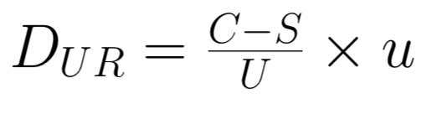
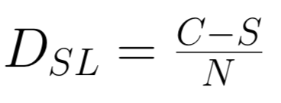
Depreciation
Usage Rate Depreciation
C: cost of the asset
S: salvage or residual value
U: Total estimated usage units during the time of the asset
u: Estimated usage in a particular period
Annual cost depends on usage
Straight Line Depreciation
C: cost of the asset
S: salvage or residual value
N: Lifetime of usage
Allocates the same cost each year

Slide 9
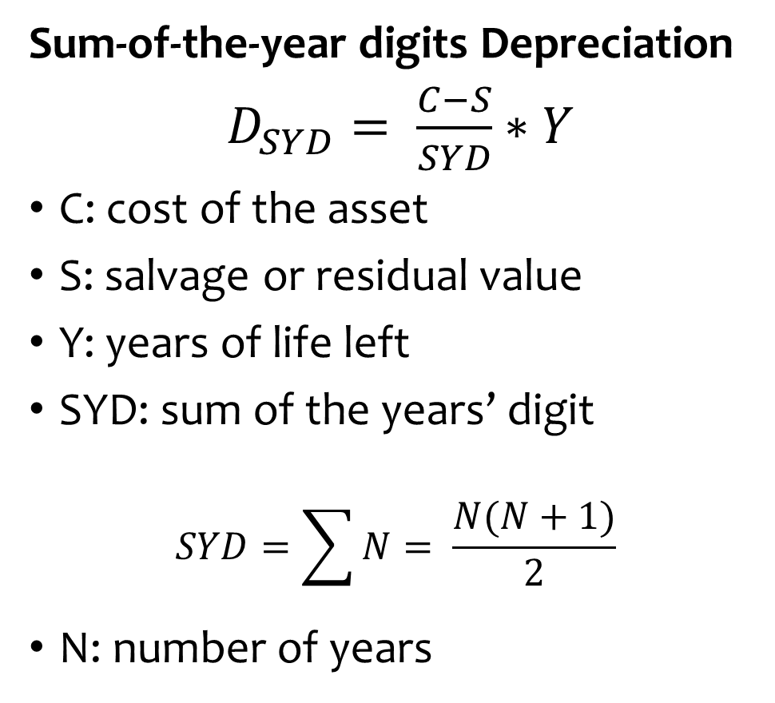
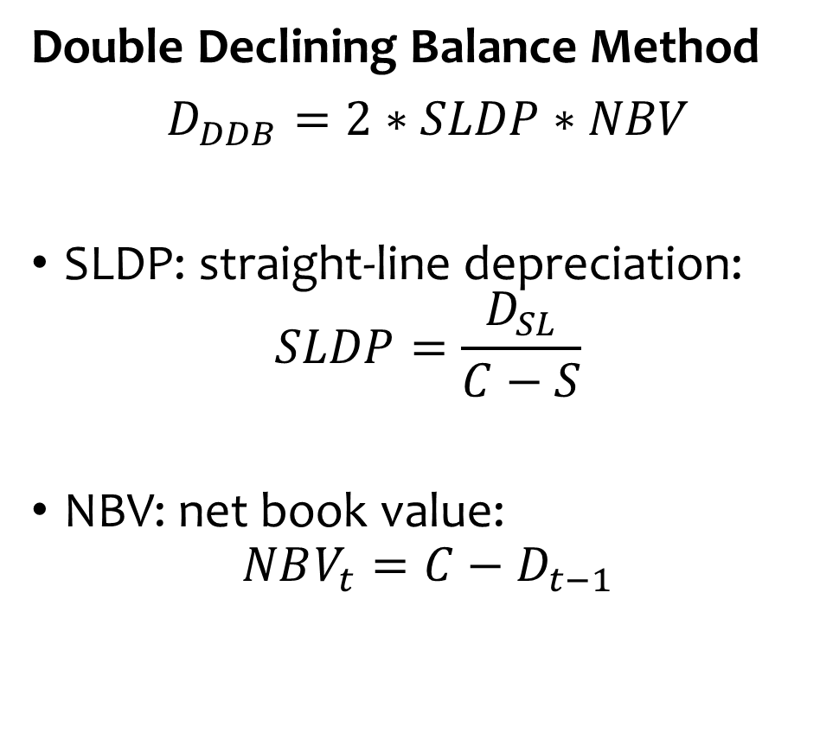
Accelerated Depreciation
Sum-of-the-year digits Depreciation
$D_{SYD}= \frac{C−S}{SYD}∗Y$
C: cost of the asset
S: salvage or residual value
Y: years of life left
SYD: sum of the years’ digit
$$SYD=\sum{N}= \frac{N(N+1)}{2}$$
N: number of years
Double Declining Balance Method
$D_{DDB}=2∗SLDP∗NBV$
SLDP: straight-line depreciation:
$$SLDP=\frac{D_{SL}}{C−S}$$
NBV: net book value:
$$NBV_{t}=C−D_{t−1}$$

Slide 10
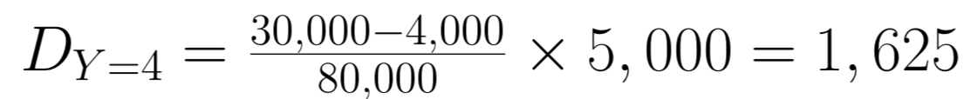
Usage Rate Depreciation - Example
A police vehicle is purchased for $30,000. The vehicle will be used for 5 years. The residual value of the vehicle after five years is $4,000.
It is driven 20,000 miles for the first three years; 5,000 for the fourth year; and 15,000 for the fifth year.
Total usage units =
Usage units (y=1) =
Usage units (y=4) =
Notes:
Accumulated Depreciation at year 4

Slide 11
Usage Rate Depreciation - Example
A police vehicle is purchased for $30,000. The vehicle will be used for 5 years. The residual value of the vehicle after five years is $4,000.
It is driven 20,000 miles for the first three years; 5,000 for the fourth year; and 15,000 for the fifth year.
Total usage units = (20,000*3)+15,000+5,000=80,000
Usage units (y=1) = 20,000
Usage units (y=4) = 5,000

Slide 12
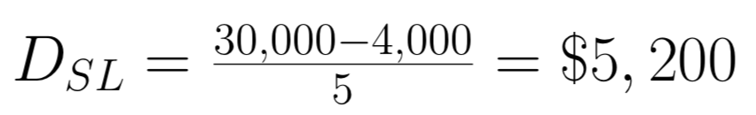
Straight Line Depreciation - Example
A police vehicle is purchased for $30,000. The vehicle will be used for 5 years. The residual value of the vehicle after five years is $4,000.
What is the depreciation in the first year?
What is the depreciation in the fourth year?
What is the accumulated depreciation in the fourth year?

Slide 13
Straight Line Depreciation - Example
A police vehicle is purchased for $30,000. The vehicle will be used for 5 years. The residual value of the vehicle after five years is $4,000.
What depreciation should you use?
What is the depreciation in the first year?
What is the depreciation in the fourth year?
What is the accumulated depreciation in the fourth year?

Slide 14
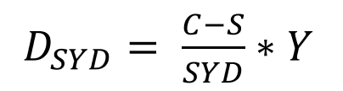
SYD Depreciation - Example
A police vehicle is purchased for $30,000. The vehicle will be used for 5 years. The residual value of the vehicle after five years is $4,000.
Using Sum-of-the digit-depreciation method (SYD)
What is the depreciation in the first year?
What is the depreciation in the fourth year?
Notes:
Note that the lifetime chosen for depreciating assets is just an estimate, and that estimate is often conservative.

Slide 15
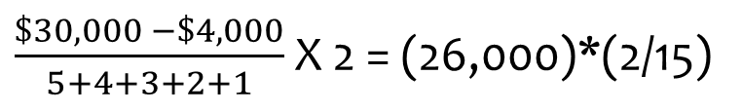
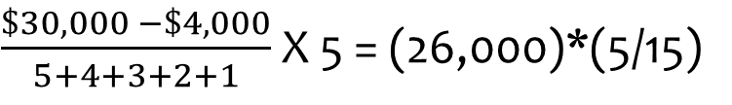
SYD Depreciation - Example
A police vehicle is purchased for $30,000. The vehicle will be used for 5 years. The residual value of the vehicle after five years is $4,000.
Using Sum-of-the digit-depreciation method (SYD)
What is the depreciation in the first year?
What is the depreciation in the fourth year?
$\frac{\$30,000 −\$4,000}{5+4+3+2+1}$ X 5 = (26,000)*(5/15)
$\frac{\$30,000 −\$4,000}{5+4+3+2+1}$ X 2 = (26,000)*(2/15)
Notes:
Note that the lifetime chosen for depreciating assets is just an estimate, and that estimate is often conservative.

Slide 16

DDB Depreciation - Example
A police vehicle is purchased for $30,000. The vehicle will be used for 5 years. The residual value of the vehicle after five years is $4,000.
Using Double declining balance method (DDB)
What is the depreciation in the first year?
What is the depreciation in the fourth year?
Notes:
Note that the lifetime chosen for depreciating assets is just an estimate, and that estimate is often conservative.

Slide 17

DDB Depreciation - Example
A police vehicle is purchased for $30,000. The vehicle will be used for 5 years. The residual value of the vehicle after five years is $4,000.
Using Double declining balance method (DDB)
What is the depreciation in the first year?
What is the depreciation in the fourth year?
$$SLDP=\frac{5200}{30,000−4,000}=0.2$$
$$D_{Y=1}=30,000∗2∗0.2=12,000$$
$$D_{Y=2}=\left(30,000−12,000\right)∗2∗0.2=7,200$$
$$D_{Y=3}=\left(30,000−12,000−7,200\right)∗2∗0.2=4,320$$
$$D_{Y=4}=\left(30,000−12,000−7,200−4,320\right)∗2∗0.2=2,592$$
Notes:
Note that the lifetime chosen for depreciating assets is just an estimate, and that estimate is often conservative.

Slide 18
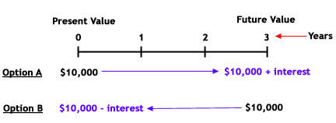
Cash is not free, investment analysis should include that cost
$10,000 dollars today vs $10,000 dollars in a year are not the same
Interest Expense:
Interest = Loan Amount x Interest Rate per year x Number of Years
Time value of money as a mechanism to help make a reasonable comparison over time
Notes:
Since we often pay for capital assets immediately and get cash receipts only as we use them later, the TVM must be considered.
When we use—that is, borrow—someone’s money, we also pay rent for that use. Rent paid for the use of someone’s money is called interest expense. For capital assets, the rental cost for money used over a period of years can be substantial, and its effect must be considered when we decide whether it makes sense to acquire the item.
As above, there also is an opportunity cost for all resources used by an organization. Each resource could be used for some other purpose. We often refer to the opportunity cost of using resources in an organization as the cost of capital. Part of the cost of capital is reflected in the interest that the organization pays on its debt. In fact, many organizations use their borrowing cost to estimate their opportunity cost. Calculations related to the cost of capital or cost of money are referred
However, TVM calculations are still required. Why? Because the museum could have put the money into some safe investment and earned a return if it did not open the proposed exhibit. to as TVM calculations.

Slide 19
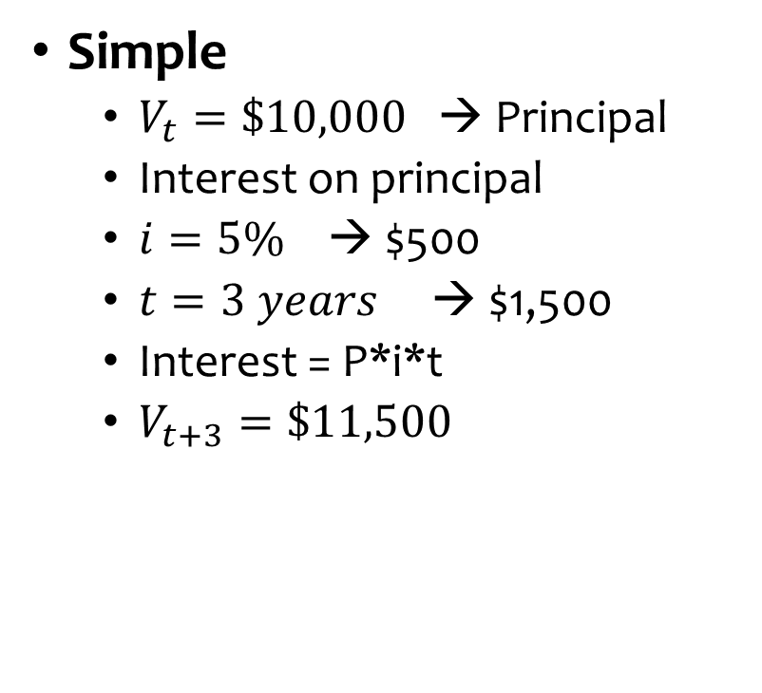
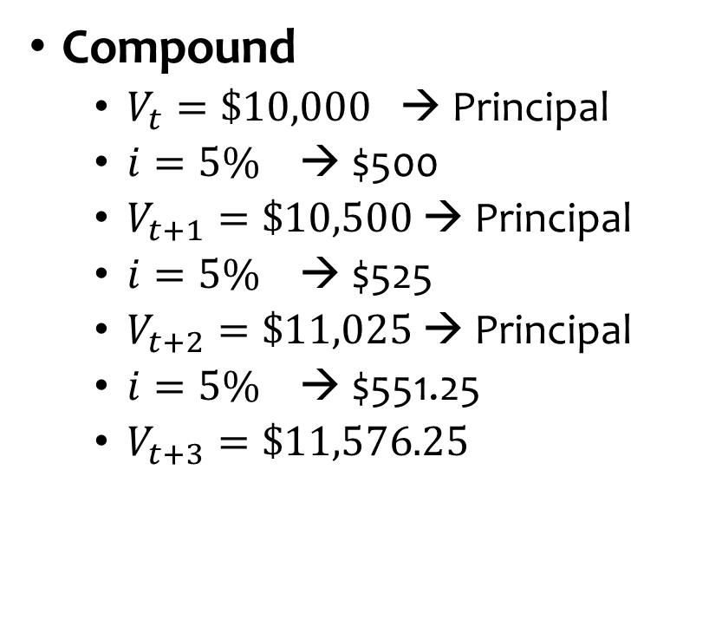
Interest
Simple
$V_{t}=\$10,000$ → Principal
Interest on principal
$i=5\%$ → $500
$t=3 years$ → $1,500
Interest = P*i*t
$V_{t+3}=\$11,500$
Compound
$V_{t}=\$10,000$ → Principal
$i=5\%$ → $500
$V_{t+1}=\$10,500$ → Principal
$i=5\%$ → $525
$V_{t+2}=\$11,025$ → Principal
$i=5\%$ → $551.25
$V_{t+3}=\$11,576.25$
Notes:
Compound interest simply refers to the fact that when money is invested, at some point going forward in time the interest earned on the money starts to earn interest itself.
Adding the interest back to the principal after each year
Compound interest is a valuable concept if we would like to know how much a certain amount of money received today is likely to be worth in the future, assuming that we could earn a certain rate of return.
Discounting is merely the reverse of compounding. If we expect an investment to earn $60,000 5 years from now, how much is that worth today? Is it worth $60,000 today? No, because if we had $60,000 today, we could earn interest and have more than $60,000 5 years from now. $60,000 5 years from now is worth less than $60,000 today. A dollar today is still worth more than a dollar tomorrow. Discounting is the process of reversing the compounding of interest.

Slide 20

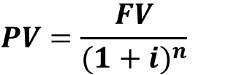






Time Value of Money
0
1
2
3
4
n
$$V_{0}$$
$$V_{1}$$
$$V_{2}$$
$$V_{3}$$
$$V_{4}$$
$$V_{n}$$
$$V_{1}=V_{0}(1+i)$$
$$V_{2}=V_{1}\left(1+i\right)=V_{0}\left(1+i\right)\left(1+i\right)=V_{0}{(1+i)}^{2}$$
$$V_{3}=V_{2}\left(1+i\right)=V_{0}{(1+i)}^{2}\left(1+i\right)=V_{0}{(1+i)}^{3}$$
…
$$FV=PV{(1+i)}^{n}$$
$$PV=\frac{FV}{{(1+i)}^{n}}$$
Notes:
There are two sides to the TVM: present value (PV) and future value (FV). The PV is the starting point of the TVM timeline. It is the value of money that will be received or paid in the future. The FV, conversely, is the endpoint of the TVM timeline. It is the value of money after time has passed. In either case, money may be a single lump-sum payment or receipt, or it may be a stream of receipts or payments. Any TVM calculation is a variation of solving for either the PV, the FV, or one of the variables that determines PV and FV.
Compounding is FV process and discounting is PV process

Slide 21
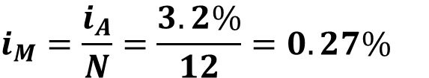
Time Value of Money - Example
Assume that you are investing $25,000 today for 10 years at an annual rate of 3.2%. How much will you have in 10 years?
$$FV=PV{(1+i)}^{n}=25,000{(1+0.032)}^{10}=34,256.03$$
Assume that you are investing the same amount for the same time of period, but the interest is compounded monthly.
$$i_{M}=\frac{i_{A}}{N}=\frac{3.2\%}{12}=0.27\%$$
$$n=12∗10=120$$
FV$=PV{(1+i)}^{n}=25,000{(1+0.27\%)}^{120}=34,551.09$

Slide 22
Time Value of Money - Example
How much money do you need to invest today at an annual interest rate of 4.3% if you want to have 20,000 in 15 years?
PV$=\frac{FV}{{(1+i)}^{n}}=\frac{20,000}{{(1+4.3\%)}^{15}}=10,635.68$
How much would you have to invest at a semi-annual interest rate of 2.15%?
$$n=2∗15=30$$
PV$=\frac{FV}{{(1+i)}^{n}}=\frac{20,000}{{(1+2.15\%)}^{30}}=10,565.23$

Slide 23




Time Value of Money - Example
What is the present value of a stream of future values that include $200 now, $500 one year from now, $500 two years from now, and $500 three years from now? At an annual discount rate of 10%
Draw the cash-flow time-line
0
1
2
3
$$200$$
$$454.5$$
$$413.2$$
$$375.7$$
$PV=200+\frac{500}{{(1+0.10)}^{1}}+\frac{500}{{(1+0.10)}^{2}}$+ $\frac{500}{{(1+0.10)}^{3}}=1,443.426$

